Slide 1
Digital Image Processing Project
by
Eren Yılmaz 20290373
Gündüz Yiğit Ünlü 20290371

Slide 2
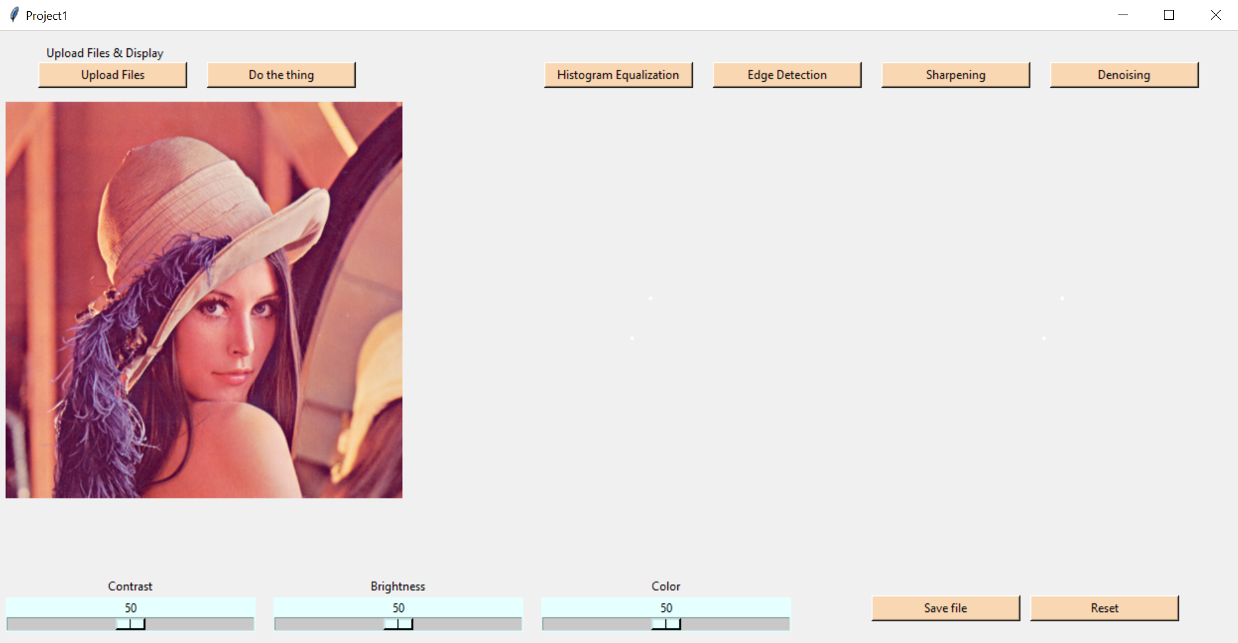
The Ultimate multi-tool image processing program designed for satisfying different needs.

Slide 3

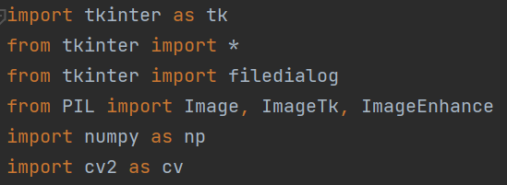
Python

Slide 4
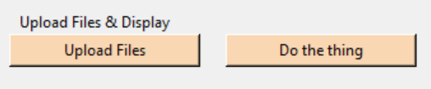
Features
Upload Button & Do the thing
Uploads selected picture and displays it
Applying the selected filter

Slide 5
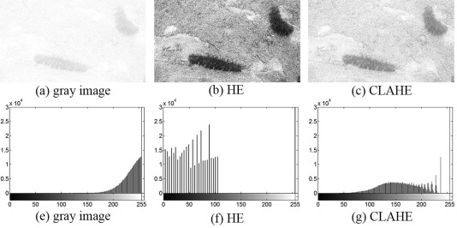
Filters
Histogram Equalization
Global Histogram Equalization CLAHE (Contrast Limited Adaptive Histogram equalization)

Slide 6

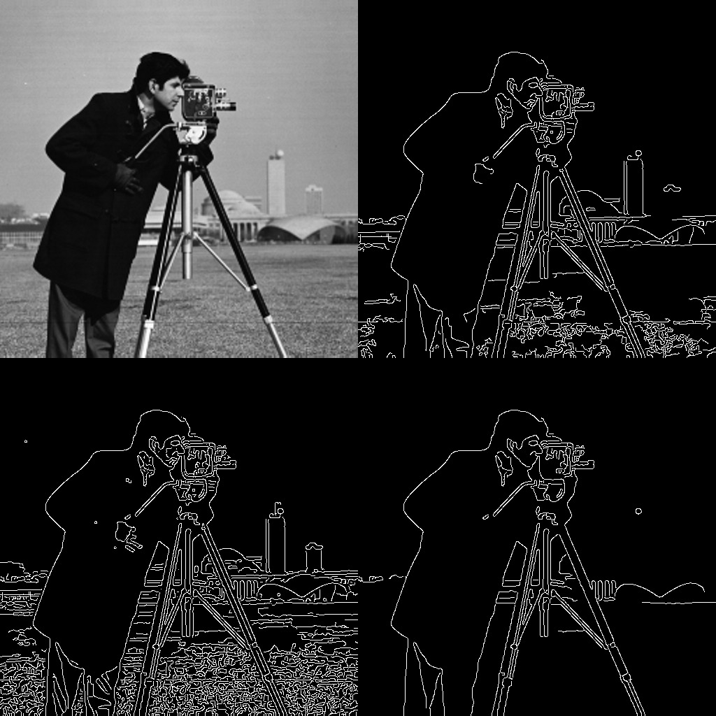
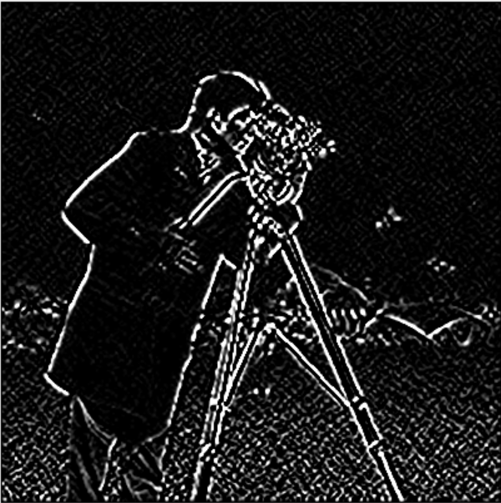
Filters
Edge Detection
Canny Edge Detection
Sobel Edge Detection

Slide 7
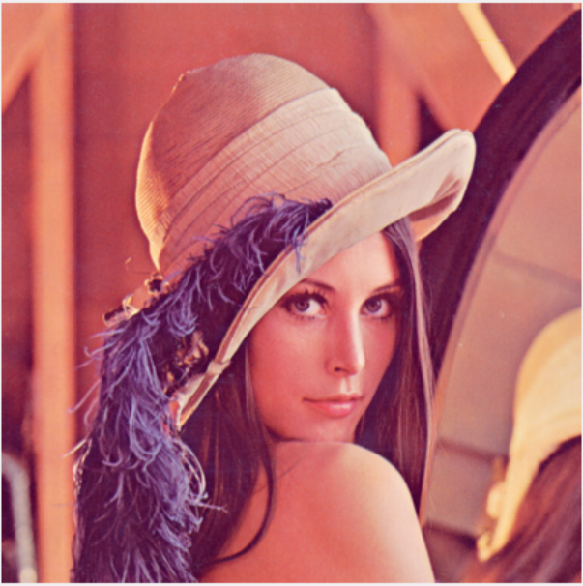
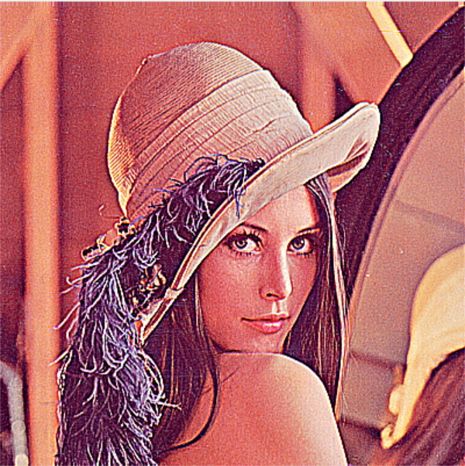
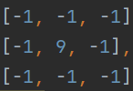
Filters
Sharpening

Slide 8
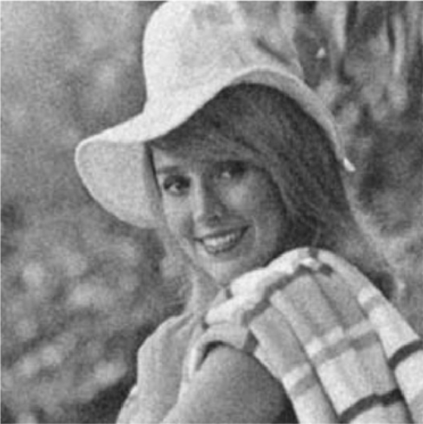
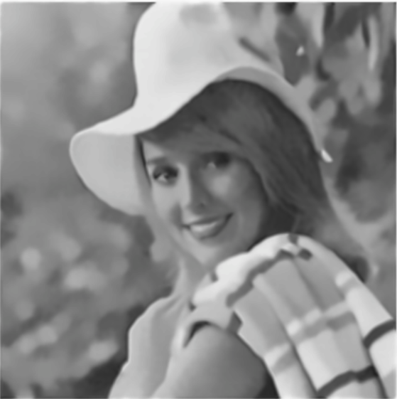
Filters
Denoising
Works better with gaussian noise

Slide 9
Features
Image color enhancement sliders
These sliders only change images color
Changes Contrast of image
Changes Brightness of image
Changes Color of image

Slide 10

Features
Save & Reset
Save file button saves the source image
after color enhancements
Reset button resets all of the color enhancements and returns slider values to 50

